Slide 1
APIs

Slide 2


Slide 3
What are APIs?
Set of programmatic instructions for accessing software applications:
application programming interface
The data that comes from APIs typically contains some sort of structure (such as JSON).
JSON: JavaScript Object Notation. Structured exactly like Python dictionaries.

Slide 4
Two ways to get data from the internet
Pretend to be human
Web scraping
:(
I WANT THIS SITE’S DATA FOR MY DATA SCIENCE PROJECT!!!!!1!
Someone has created a Python wrapper
:)
Ask nicely
APIs
I need to write the request
:|

Slide 5
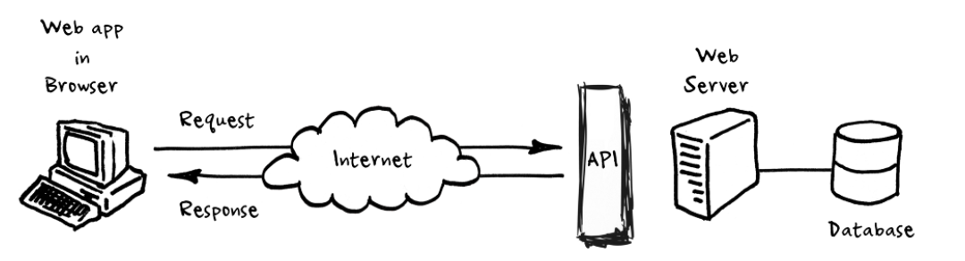
What is it?
https://medium.com/@perrysetgo/what-exactly-is-an-api-69f36968a41f

Slide 6
RESPONSE
200 Success: This means everything worked as expected and the resource is found on the SERVER
4xx Client errors: Those are codes for errors on the client side, meaning the client asked for a wrong resource or the one that everybody knows 404 that means resource can't be found on the SERVER.
5xx Server errors: This means the SERVER itself crashed when processing your REQUEST. Maybe due to a bug on server's code or something related.
https://en.wikipedia.org/wiki/List_of_HTTP_status_codes

Slide 7
REQUEST
response = requests.get('https://api.github.com')
response.status_code
response.content
response.text
response.json()
response.headers
200 = good, 404 = bad
Raw content
Content nicely encoded (UTF-8)
Json content transformed to dict
Useful info

Slide 8
HTTP
Hypertext Transfer Protocol is an application protocol for distributed, collaborative, hypermedia information systems.
HTTP is the foundation of data communication for the World Wide Web
HTTP functions as a request–response protocol in the client–server computing model.
A web browser, for example, may be the client (asking the question) and an application running on a computer hosting a website may be the server (responding to the question)
https://en.wikipedia.org/wiki/Hypertext_Transfer_Protocol

Slide 9
JSON files
JavaScript Object Notation (JSON) is a standard text-based format for representing structured data based on JavaScript object syntax. It is commonly used for transmitting data in web applications (e.g., sending some data from the server to the client, so it can be displayed on a web page, or vice versa)

Slide 10
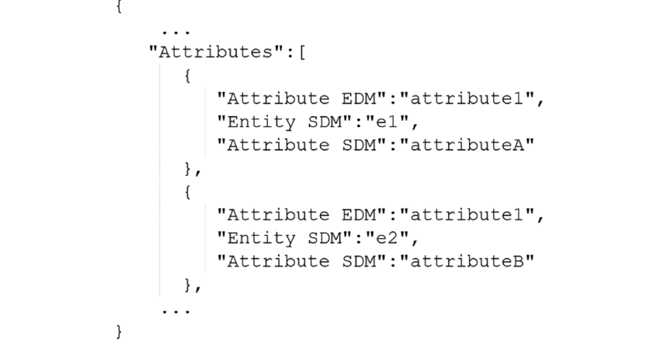
Example of JSON

Slide 11
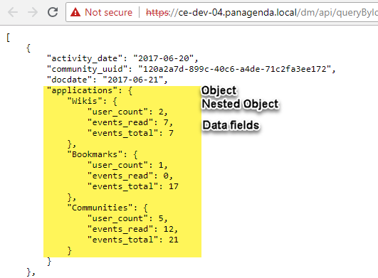
Flatten JSON
Use the Flatten JSON Objects extension to convert a nested data layer object into a new object with only one layer of key/value pairs

